Slide 1
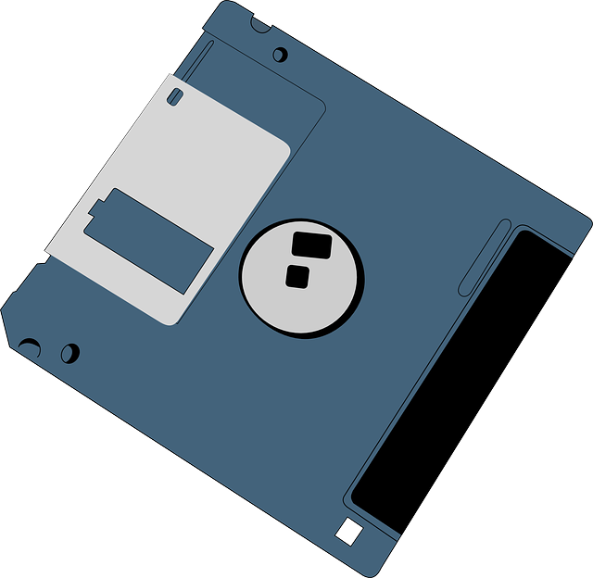
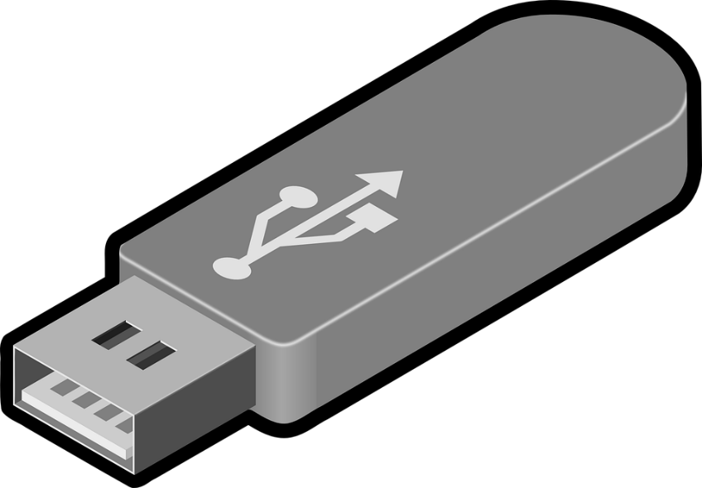
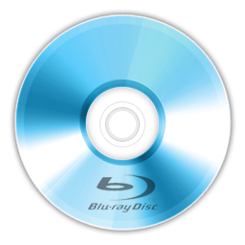
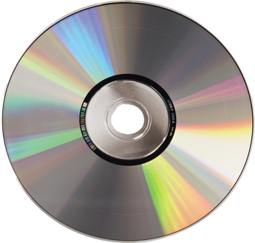
Removable Media
By: Javon

Slide 2
What is it
Removable media is any type of storage device that can be removed from a computer while the system is running. Examples of removable media include CDs, DVDs and Blu-Ray disks, as well as diskettes and USB drives. Removable media makes it easy for a user to move data from one computer to another.

Slide 3
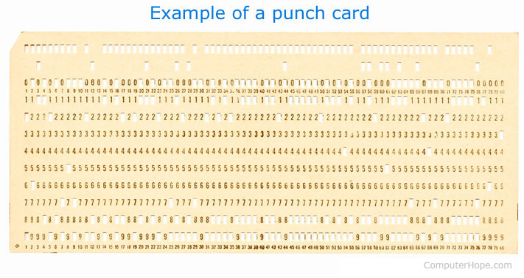
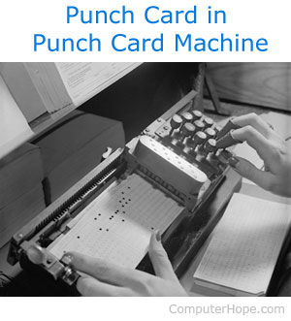
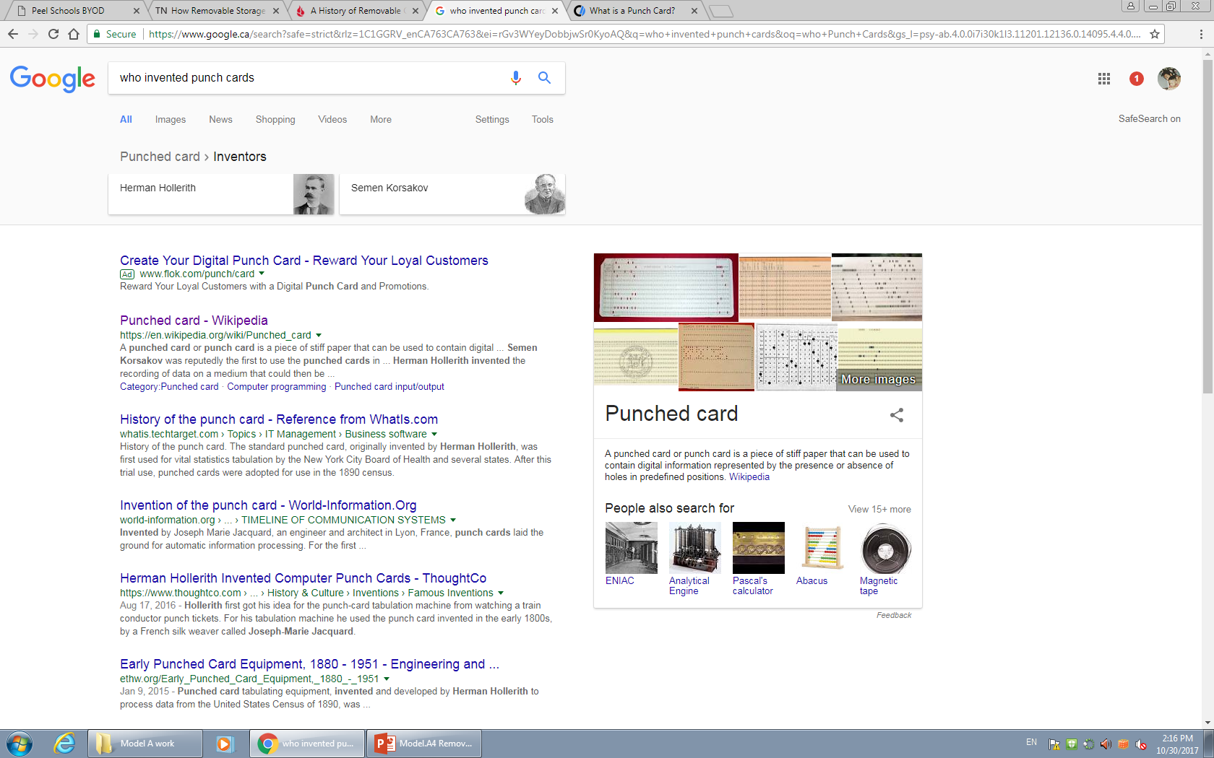
The birth of removable storage (Punch Cards)
Early method of data storage used with early computers. Punch cards also known as Hollerith cards and IBM cards are paper cards containing several punched or perforated holes that were punched by hand or machine to represent data. These cards allowed companies to store and access information by entering the card into the computer.

Slide 4
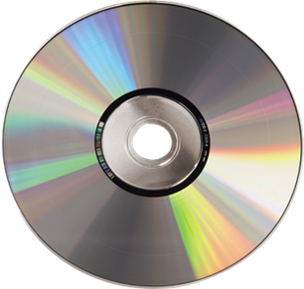
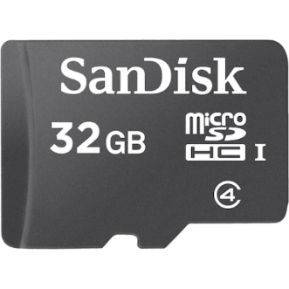
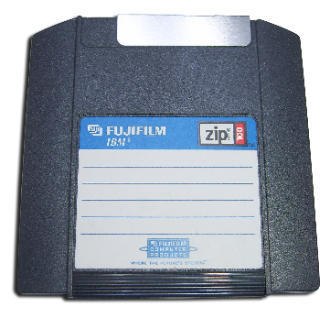
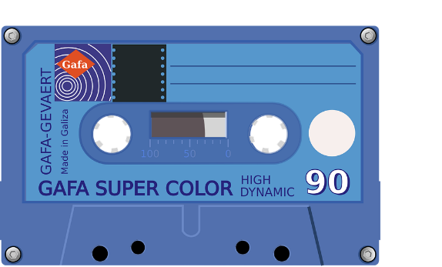
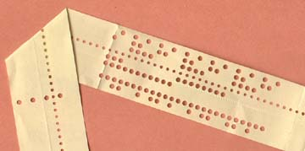
Types of removable media
In computer storage, some types of removable media are designed to be read to or written to by removable readers, writers and drives.
Examples include:
Optical discs (Blu-ray discs, DVDs, CDs)
Memory cards (CompactFlash card, Secure Digital card, Memory Stick)
Zip disks/other Floppy disks
Disk packs
Magnetic tapes
Paper data storage (punched cards, punched tapes)

Slide 5
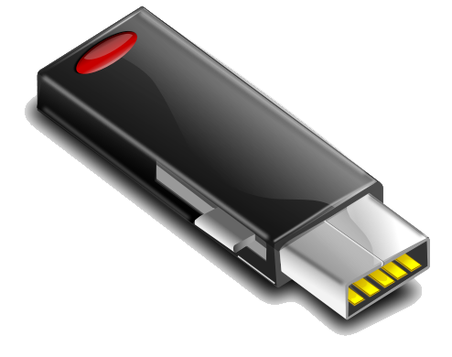
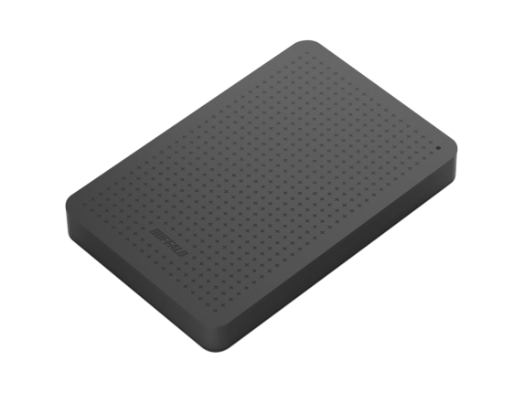
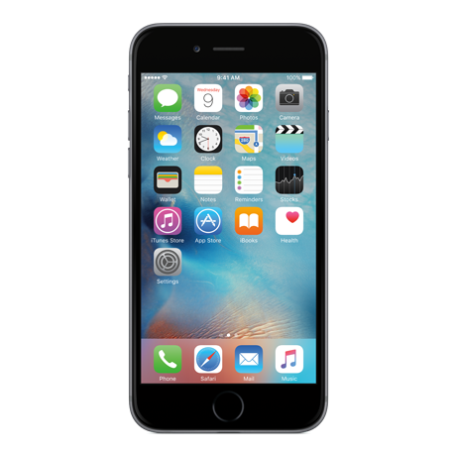
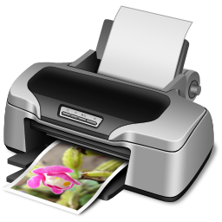
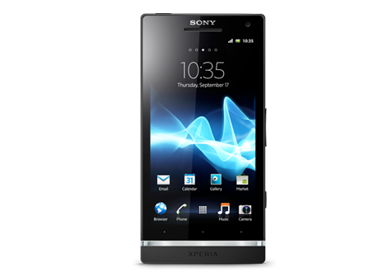
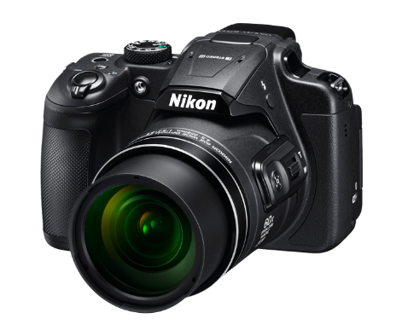
Removable storage devices
USB flash drives
External hard disk drives; traditional IDE, EIDE, SCSSI, and SSD, for example
Devices that are common today may include
Digital cameras
Smart phones
Wired or Wireless printers

Slide 6
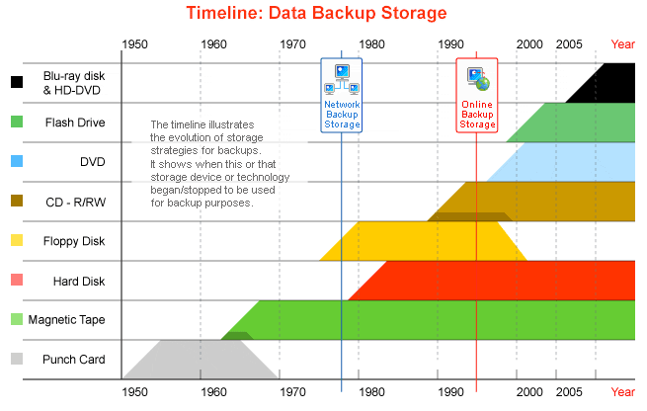
Timeline of removable media

Slide 7
Work cited
http://searchdatabackup.techtarget.com/definition/removable-media
https://en.wikipedia.org/wiki/Removable_media
http://www.backuphistory.com/

